Slide 1

React Overview

Slide 2
React Introduction
What is React?
  React is a JavaScript library for rendering user interfaces (UI)

Slide 3
React History
In 2011, Jordan Walke, a software engineer at Facebook, created this library and used by Facebook
In 2013, Facebook officially made it an open-source (https://github.com/facebook/react)
In 2015, React Native was announced and available for iOS and then launched for Android in the same year.
In 2018, React 16.3.0 was released.
In 2019, new React DevTools were released.
Now, latest 18.2.0 (June 14, 2022)

Slide 4
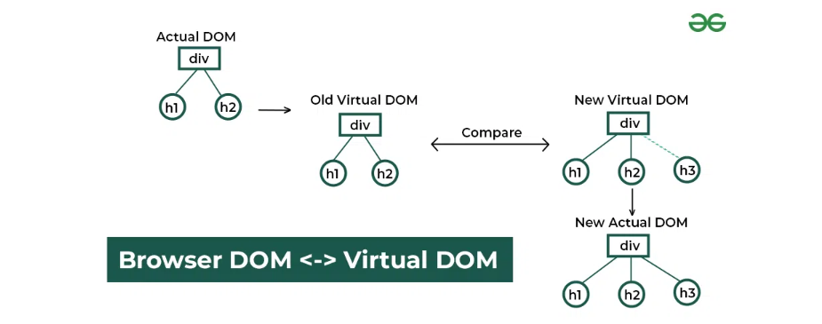
How does React work?
React creates a virtual DOM in memory to update the browser’s DOM. The virtual DOM will try to find the most efficient way to update the browser’s DOM.

Slide 5
React Installation
React environment setup
  NodeJS
Ways to install React
  Create React App (https://create-react-app.dev/)
  webpack and babel
  Add React to a Website

Slide 6
React Features
Virtual DOM
JSX
Components
One-way Data Binding
Simplicity
Performance

Slide 7
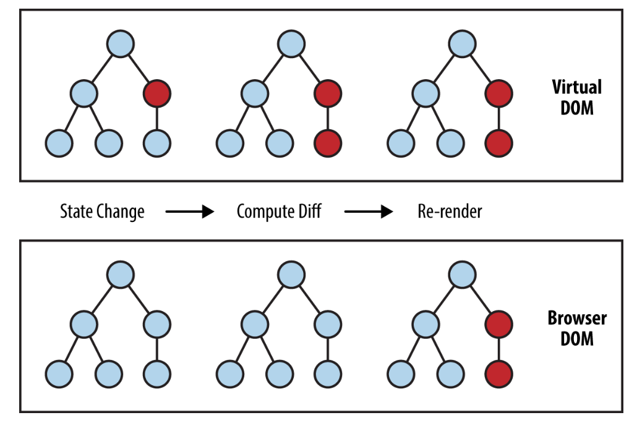
Virtual DOM
Manipulating DOM is slow, but manipulating Virtual DOM is fast
How does virtual DOM work?
How does React use Virtual DOM?

Slide 8
JSX
JSX is a syntax extension for JavaScript that lets you write HTML-like markup inside a JavaScript file
The rules of JSX
  Return a single root element
  Close all the tags
  Use className and data-* attributes
  Use curly braces
  Use “double curlies”: CSS and other objects

Slide 9
Components
User interfaces can be broken down into smaller building blocks called components.
A React component is a JavaScript function that you can sprinkle with markup
Functional Components and Class Components
Reusable UI elements for your app
Components Pure
  It minds its own business
  Same inputs, same output

Slide 10
Props
React components use props to communicate with each other
Pros value including objects, arrays, and functions
Passing JSX as children

Slide 11
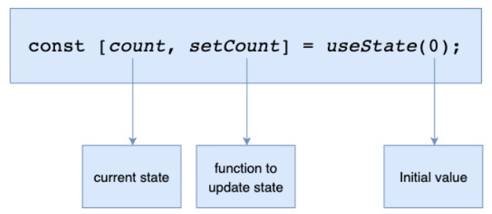
State
In React, this kind of component-specific memory is called state.
Use a state variable when a component needs to “remember” some information between renders
Giving a component multiple state variables. Internally, React matches them up by their order
State is isolated and private

Slide 12
Render And Commit
Process of requesting and serving UI has three steps
  Triggering a render (initial render and state has been updated)
  Rendering the component (is React calling your components)
  Committing to the DOM

Slide 13
How To State Work?
Setting state requests a new render.
State as a Snapshot
Event handlers created in the past have the state values from the render in which they were created.
React processes state updates after event handlers have finished running. This is called batching
To update some state multiple times in one event, you can use updater function

Slide 14
Updating State
Updating Objects
  Use the {...obj, something: 'newValue'} object spread syntax to create copies of objects
  To reduce repetitive copying code, use Immer
Updating Arrays
  Use the [...arr, newItem] array spread syntax to create arrays with new items
  Use filter() and map() to create new arrays with filtered or transformed items
  Use Immer to keep your code concise.

Slide 15
Sharing State Between Components
When you want to coordinate two components, move their state to their common parent. This is known as lifting state up
Then pass the information down through props from their common parent.
Finally, pass the event handlers down so that the children can change the parent’s state.

Slide 16
Hook
Hooks are special functions that start with use.
Calling Hooks is only valid at the top level of a component or another Hook
Hook returns a pair of values: the current state and the function to update it
Important Hooks: State Hooks, Context Hooks, Ref Hooks, Effect Hooks

Slide 17
Thinking in React
Implement a UI in React
Step 1: Break the UI into a component hierarchy
Step 2: Build a static version in React
Step 3: Find the minimal but complete representation of UI state
Step 4: Identify where your state should live
Step 5: Add inverse data flow

Slide 18

Q & A

Slide 19
References
https://react.dev/learn
https://react.dev/learn
https://legacy.reactjs.org/tutorial/tutorial.html
https://www.geeksforgeeks.org/reactjs-tutorials/
https://create-react-app.dev/docs/getting-started/
https://www.tutorialsfreak.com/reactjs-tutorial/react-history
https://programmingwithmosh.com/react/react-virtual-dom-explained/

Slide 20

Thank you

